Slide 1
CS 107: Computer Architecture and Organization
SBCC
Spring 2020

Slide 2
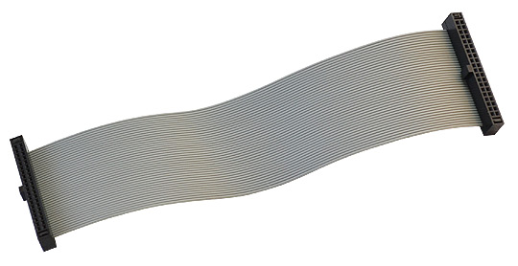
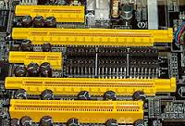
What is a bus?
Electrical channels that allow various devices inside the computer to communicate with each other
Bus width determines the number of bits transmitted at one time.
Bus speed determines the rate at which data can be transferred per second, often expressed in MHz
Parallel interface.

Slide 3
Serial Interfaces
In computing, a “serial communication interface” is the interface through which information transfers in or out one bit at a time (in contrast to a parallel interface).
Throughout most of the history of personal computers, data was transferred through serial ports to devices such as modems, terminals and various peripherals.
Between computer and peripherals
Intra-board
Between CPU and Memory, ADC, Sensors, etc.
RS232, USB, CAN, Ethernet, Wi-Fi, Bluetooth
SPI, I2S, I2C, 1-Wire
Synchronous
Asynchronous
A clock line provided that is common to the source and destination Pulse appearing on the clock line serve to separate individual bits. Both the source and the destination use the same clock pulses as a time reference for the occurrence of each data bit.
No clock line provided. Instead, the source and the destination each determine the time for each bit by precisely measuring the time from beginning of the data word. For this purpose, the source must mark the beginning of the word in a way recognizable to the destination.

Slide 4
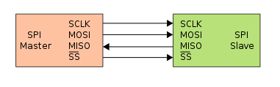
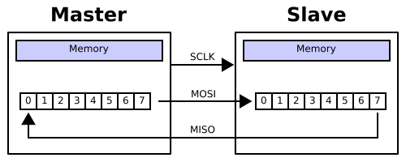
Serial Interfaces
The Serial Peripheral Interface bus (SPI) is a synchronous serial communication interface specification used for short distance communication, primarily in embedded systems.
Developed by Motorola in the late 80’s
Become a de facto standard.
Master – Slave interface.
High speed (tenths of MHz).
-8, -16, -32 bits data.
Simple and reliable
Typical applications:
High speed ADCs and DACs.
Memory (serial RAM or ROM).
MMC or SD Cards.
LCD displays.
The SPI bus typically specifies four logic signals:
SCLK: Serial Clock (output from master).
MOSI: Master Out Slave In (data output from master).
MISO: Master In Slave Out (data output from slave).
SS: Slave Select (often active low, output from master).

Slide 5
Serial Interfaces
The Serial Peripheral Interface bus (SPI) is a synchronous serial communication interface specification used for short distance communication, primarily in embedded systems.
Developed by Motorola in the late 80’s
Become a de facto standard.
Master – Slave interface.
High speed (tenths of MHz).
-8, -16, -32 bits data.
Simple and reliable
Typical applications:
High speed ADCs and DACs.
Memory (serial RAM or ROM).
MMC or SD Cards.
LCD displays.
The SPI bus typically specifies four logic signals:
SCLK: Serial Clock (output from master).
MOSI: Master Out Slave In (data output from master).
MISO: Master In Slave Out (data output from slave).
SS: Slave Select (often active low, output from master).
LSL/RRX command
C-bit

Slide 6
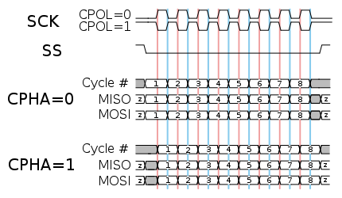
Serial Interfaces
The Serial Peripheral Interface bus (SPI) is a synchronous serial communication interface specification used for short distance communication, primarily in embedded systems.
SCLK
MOSI
MISO
On falling edge of SCLK Master and Slave both set the data bit on MOSI or MISO line
On next falling edge of SCLK Master and Slave both set the next data bit on MOSI or MISO line
On rising edge of SCLK Master and Slave both read the state of MOSI or MISO line and shift the data in the shift register
On rising edge of SCLK next bit is sampled by Master and Slave
MSB or LSB first
Full duplex or command-response

Slide 7
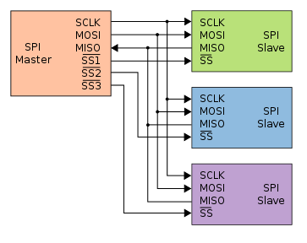
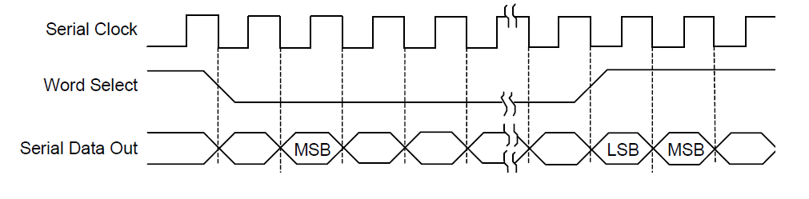
Serial Interfaces
The Serial Peripheral Interface bus (SPI) is a synchronous serial communication interface specification used for short distance communication, primarily in embedded systems.
I²S (Inter-IC Sound)
Word Select – Left or Right channel.
Time Division Multiplexed (TDM) with Frame Sync
SSx may be GPIO pins.
Some controllers have hardware support for slave selects.
Different speeds and/or data format may be programmed for different SS signals.
Suitable for a wide range of sample frequencies (fs), including 32kHz, 44.1kHz, 48kHz, 88.2kHz, 96kHz, and 192kHz
32-, 24-, 20-, 18-, 16-, and 8-bit data for mono or stereo signals

Slide 8

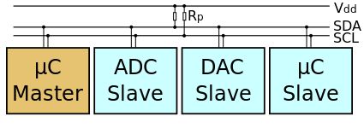
Serial Interfaces
I²C (Inter-Integrated Circuit), pronounced I-squared-C, is a master-slave serial computer bus invented by Philips Semiconductor (now NXP Semiconductors). It is typically used for attaching lower-speed peripheral ICs to processors and microcontrollers in short-distance, intra-board communication. Alternatively I²C is spelled I2C (pronounced I-two-C) or IIC (pronounced I-I-C).
Master-Slave
Two bidirectional lines, Serial Data Line (SDA) and Serial Clock Line (SCL)
Typically 100 kb/s, 400 kb/s (up to 1Mb/s in latest revisions)
Master node – node that generates the clock and initiates communication with slaves
Slave node – node that receives the clock and responds when addressed by the master
7 or 10 bit address.
Typical applications:
Low and medium speed ADCs and DACs.
EEPROM Memory.
I/O registers.
Clock generators
Battery chargers/monitors
Real-time clocks
Sensors (accelerometers, gyros, etc.)

Slide 9
Serial Interfaces
I²C (Inter-Integrated Circuit), pronounced I-squared-C, is a master-slave serial computer bus invented by Philips Semiconductor (now NXP Semiconductors). It is typically used for attaching lower-speed peripheral ICs to processors and microcontrollers in short-distance, intra-board communication. Alternatively I²C is spelled I2C (pronounced I-two-C) or IIC (pronounced I-I-C).
Typical I2C transaction (24C32 Serial EEPROM)
1 = Read
0 = Write

Slide 10
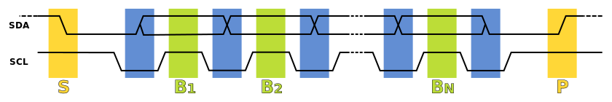
Serial Interfaces
I²C (Inter-Integrated Circuit), pronounced I-squared-C, is a master-slave serial computer bus invented by Philips Semiconductor (now NXP Semiconductors). It is typically used for attaching lower-speed peripheral ICs to processors and microcontrollers in short-distance, intra-board communication. Alternatively I²C is spelled I2C (pronounced I-two-C) or IIC (pronounced I-I-C).
I2C Timing
Data Transfer is initiated with a START bit (S) signaled by SDA being pulled low while SCL stays high.
SDA sets the 1st data bit level while keeping SCL low (during blue bar time) .
The data is sampled (received) when SCL rises (green) for the first bit (B1).
This process repeats, SDA transitioning while SCL is low, and the data being read while SCL is high (B2, Bn).
A STOP bit (P) is signaled when SDA is pulled high while SCL is high.

Slide 11
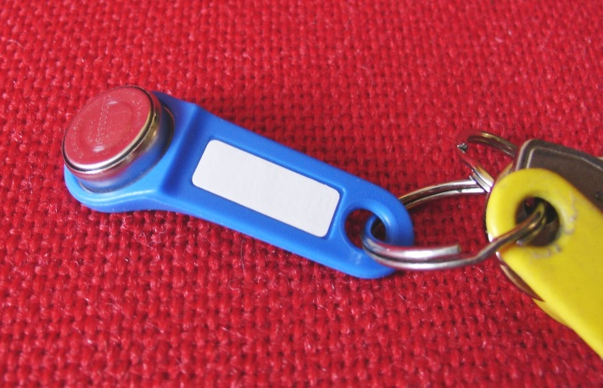
Serial Interfaces
1-Wire is a device communications bus system designed by Dallas Semiconductor Corp. that provides low-speed data, signaling, and power over a single conductor.
Vcc
Master-Slave.
Only one bidirectional line.
May be powered by data line.
Low speed.
May be more than one device connected to the line (Addressing mode).
Typical applications:
Low speed sensors (Temperature, Pressure, etc.)
EEPROM Memory.
ID, Serial number storage.
Real-time clocks.
µC
C
iButton

Slide 12
Serial Interfaces
1-Wire is a device communications bus system designed by Dallas Semiconductor Corp. that provides low-speed data, signaling, and power over a single conductor.
Master Writes to Slave
Master Reads from Slave
Master set data line to Low.
Master start sampling delay
Slave takes control over the line
Master set data line to Low.
Slave starts sampling time delay.
If sending ‘1’, Master set the line to high before Sampling delay
If sending ‘1’, Slave set the line to high before Sampling delay
Hi
Hi
If sending ‘0’, Master set the line to high after Sampling delay
If sending ‘0’, Slave set the line to high after Sampling delay
Low
Low
Hi
Hi
Low
Low
Slave reads state of data line – 0 or 1
Master reads state of data line – 0 or 1
Sampling delay
Sampling delay
Command-response

Slide 13
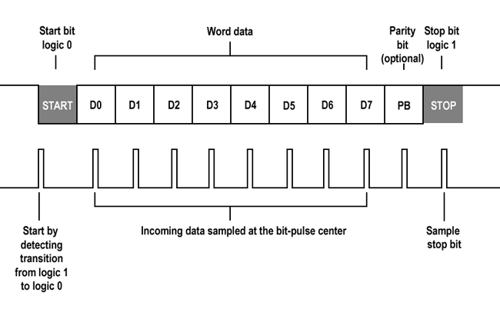
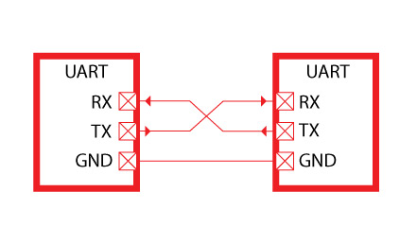
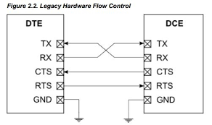
Serial Interfaces
A universal asynchronous receiver/transmitter (UART), is a computer hardware device for asynchronous serial communication in which the data format and transmission speeds are configurable.
UARTs are commonly used in conjunction with communication standards such as RS-232, RS-422 or RS-485.
Start Bit (0)
5 to 8 Data Bits
Optional Parity bit (Odd, Even)
1, 1.5 or 2 Stop Bit(s) (1)
1.5 bits
75 - 115000 bits/s
9600, 8, 1, No Parity
1 bit

Slide 14
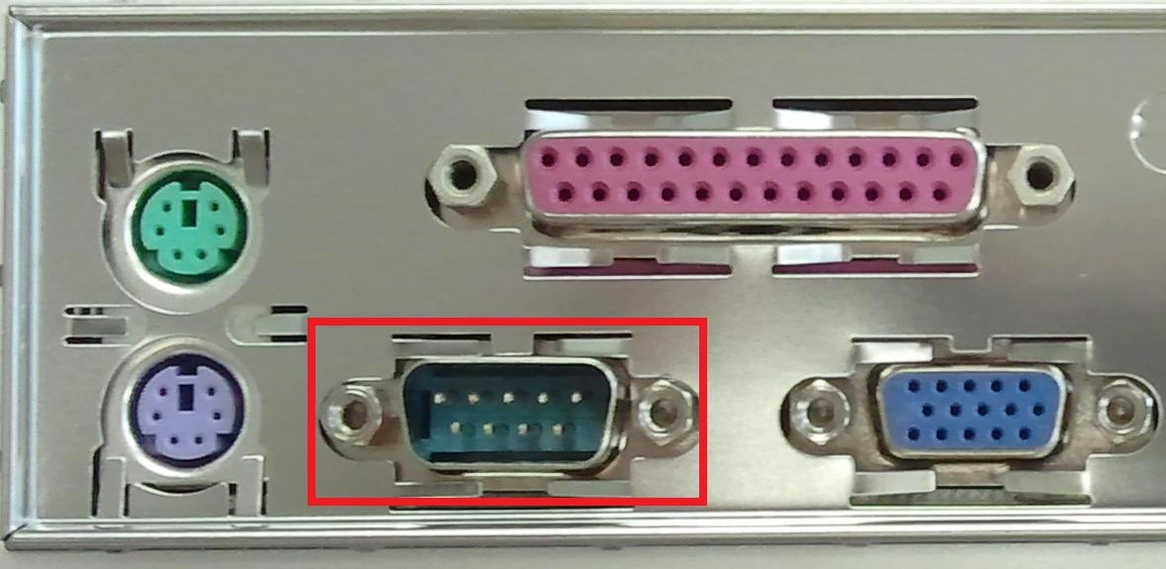
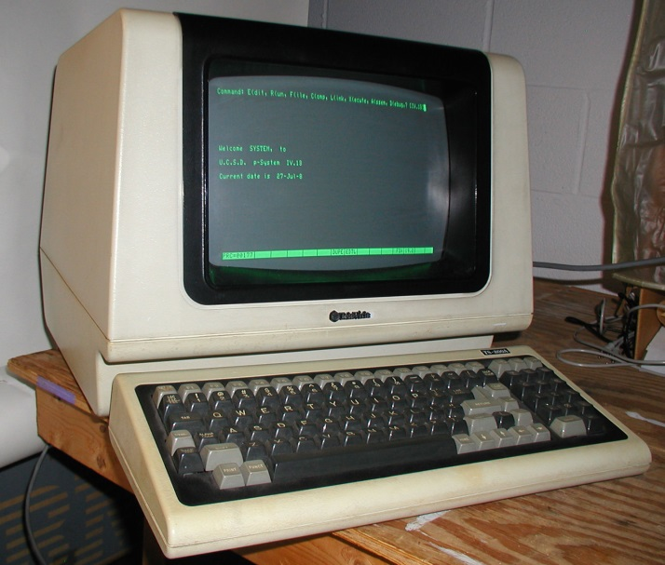
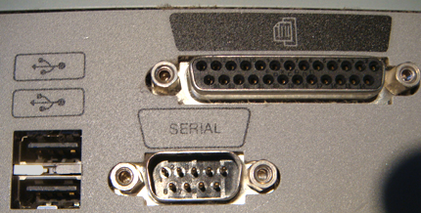
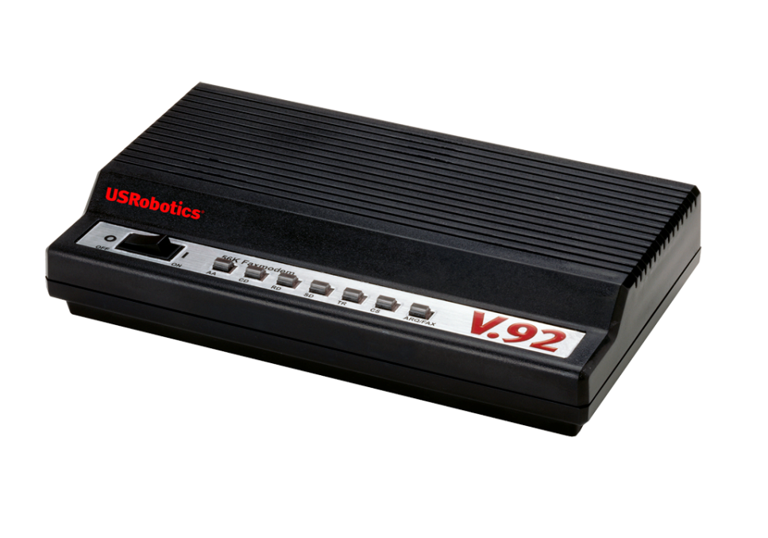

Serial Interfaces
A universal asynchronous receiver/transmitter (UART), is a computer hardware device for asynchronous serial communication in which the data format and transmission speeds are configurable.

Slide 15
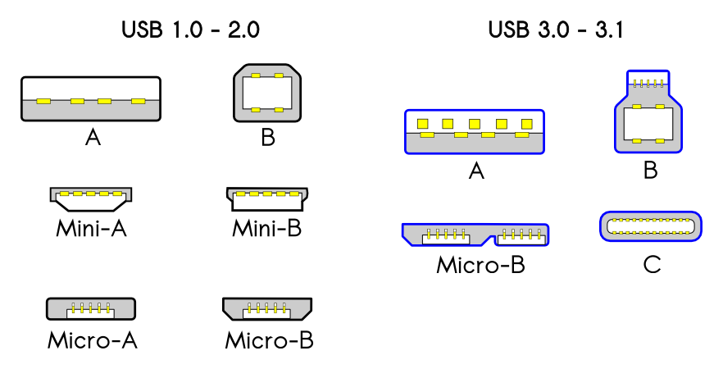
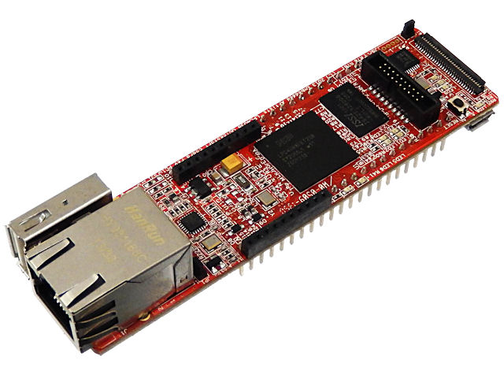
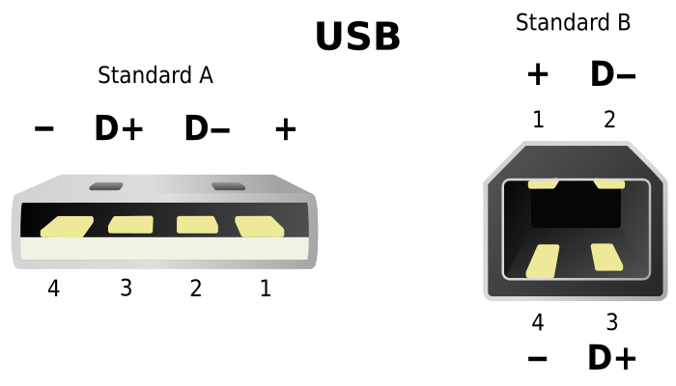
Serial Interfaces
USB, short for Universal Serial Bus, is an industry standard initially developed in the mid-1990s that defines the cables, connectors and communications protocols used in a bus for connection, communication, and power supply between computers and electronic devices.
USB was designed to standardize the connection of computer peripherals
Keyboards;
pointing devices (mouses);
digital cameras;
Printers;
portable media players;
disk drives;
network adapters;
It has become commonplace on other devices, such as smartphones, PDAs and video game consoles.
USB has effectively replaced a variety of earlier interfaces, such as:
serial ports;
parallel ports;
separate power chargers for portable devices.
USB 1.0 Jan. 1996 Low Speed (1.5 Mbit/s)
USB 1.1 Aug. 1998 Full Speed (12 Mbit/s)[25]
USB 2.0 Apr. 2000 High Speed (480 Mbit/s)
USB 3.0 Nov. 2008 SuperSpeed (5 Gbit/s)
USB 3.1 Jul 2013 SuperSpeed+ (10 Gbit/s)
Pin 1 VBUS (+5 V)
Pin 2 Data−
Pin 3 Data+
Pin 4 Ground

Slide 16
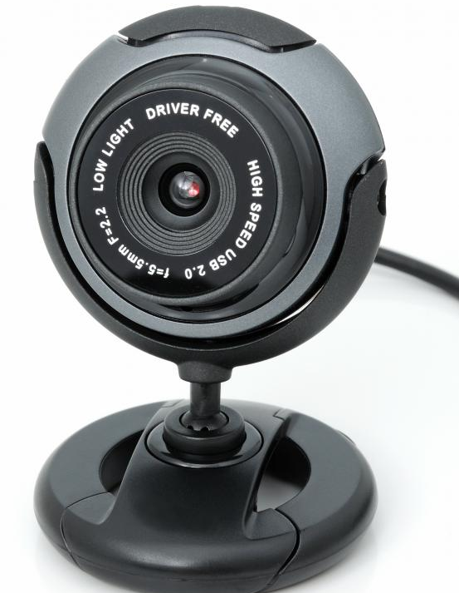
Serial Interfaces
USB, short for Universal Serial Bus, is an industry standard initially developed in the mid-1990s that defines the cables, connectors and communications protocols used in a bus for connection, communication, and power supply between computers and electronic devices.
Host and multiple peripheral devices connected in a tiered-star topology (up to 127 devices)
Composite Devices
A physical USB device may consist of several logical sub-devices that are referred to as device functions.
Host
Device
Video
Device
Audio
Device
Device
Hub
Device
Device
Device

Slide 17
Serial Interfaces
USB, short for Universal Serial Bus, is an industry standard initially developed in the mid-1990s that defines the cables, connectors and communications protocols used in a bus for connection, communication, and power supply between computers and electronic devices.
USB device communication is based on pipes (logical channels). A pipe is a connection from the host controller to a logical entity, found on a device, and named an endpoint.
USB Device descriptor:
Vendor ID/Product ID
Device Class
Endpoints description
Etc.
Host
Device
Class | Description | Examples
0x01 | Audio | Speaker, microphone, sound card, MIDI.
0x02 | CDC | Modem, Ethernet adapter, Wi-Fi adapter, RS232 serial adapter.
0x03 | HID | Keyboard, mouse, joystick.
0x06 | Image | Webcam, scanner.
0x07 | Printer | Laser printer, inkjet printer.
0x08 | MSC | USB flash drive, memory card reader, digital audio player, digital camera, external drive.
0x0E | Video | Webcam
0xFF | Vendor-specific | Indicates that a device needs vendor-specific drivers.
Pipe 1
Endpoint 1
Pipe 2
Endpoint 2
Pipe 3
Endpoint 3

Slide 18
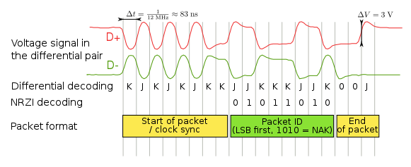
Serial Interfaces
USB, short for Universal Serial Bus, is an industry standard initially developed in the mid-1990s that defines the cables, connectors and communications protocols used in a bus for connection, communication, and power supply between computers and electronic devices.
Signal | Line transition state | Description | D+ | D-
J | Same as Idle line state | This is present during a transmission line transition. Alternatively, it is waiting for a new packet. | Hi | Lo
K | Inverse of the J state | This is present during a transmission line transition. | Lo | Hi
SE0 | Single-Ended Zero | Both D+ and D− is low. This may indicate an end of packet signal or a detached USB device. | Lo | Lo
SE1 | Single-Ended One | This is an illegal state and should never occur. This is seen as an error. | Hi | Hi
USB data is transmitted by toggling the data lines between the J state and the opposite K state.
0 bit is transmitted by toggling the data lines from J to K or vice versa.
1 bit is transmitted by leaving the data lines as-is.
To ensure that there is enough signal transitions for clock recovery to occur in the bitstream, bit stuffing techniques is applied to the data stream. This is via inserting extra 0 bit into the data stream after any appearance of six consecutive 1 bits (Thus ensuring that there is a 0 bit to cause a transmission state transition). Seven consecutive received 1 bits is always an error.
Sync: Line transitions KJKJKJKK
(00000001₂)
Data: Line transitions JJKKKJJK
(NAK - 01011010₂)
EOP: SE0 + SE0 + J

Slide 19
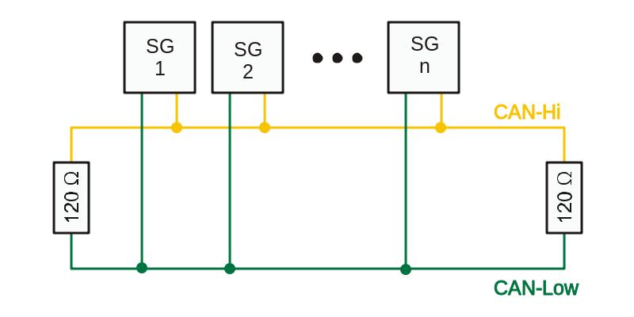
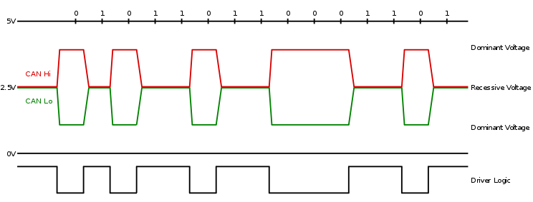
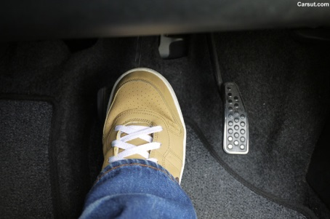
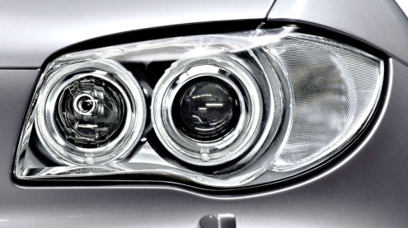
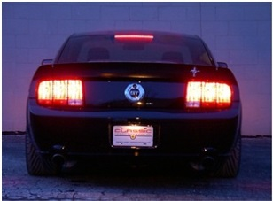
Serial Interfaces
A Controller Area Network (CAN bus) is a vehicle bus standard designed to allow microcontrollers and devices to communicate with each other in applications without a host computer. It is a message-based protocol, designed originally for multiplex electrical wiring within automobiles, but is also used in many other contexts.
High speed CAN signaling drives the CAN high wire towards 5V and the CAN low wire towards 0V when transmitting a dominant (0), and does not drive either wire when transmitting a recessive (1). The dominant differential voltage is a nominal 2V. The termination resistor passively returns the two wires to a nominal differential voltage of 0V.
Msg: I am pressed!
Ok!

Slide 20
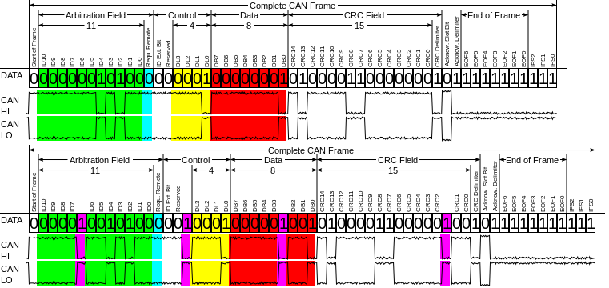
Serial Interfaces
A Controller Area Network (CAN bus) is a vehicle bus standard designed to allow microcontrollers and devices to communicate with each other in applications without a host computer. It is a message-based protocol, designed originally for multiplex electrical wiring within automobiles, but is also used in many other contexts.
Identifier (green) - 11 or 29 bits – A (unique) identifier
which also represents the message
priority
Data length code (DLC) (yellow) – 4 bits –
Number of bytes of data (0–8 bytes)
Data field (red) – 0 - 64 bits –
Data to be transmitted
CRC – 15 bits –
Cyclic redundancy check.
To ensure enough transitions to maintain synchronization, a bit of opposite polarity is inserted after five consecutive bits of the same polarity. This practice is called bit stuffing, and is necessary due to the non-return to zero (NRZ) coding used with CAN. The stuffed data frames are destuffed by the receiver.
 | Start bit | MSG Bits
 |  | 10 | 9 | 8 | 7 | 6 | 5 | …
Msg1 | 0 | 0 | 0 | 1 | Stop transmit
Msg2 | 0 | 0 | 0 | 0 | 1 | 0 | 1 | …
CAN Data | 0 | 0 | 0 | 0 | 1 | 0 | 1 | …

Slide 21
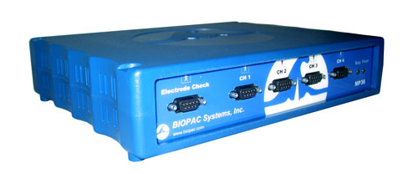
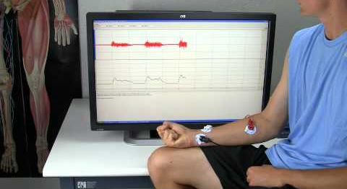
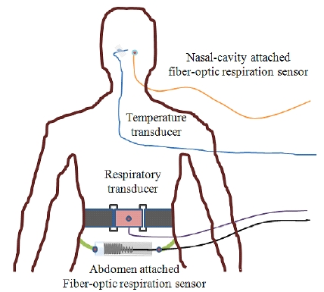
Serial Interfaces
USB
Analog Signals
SPI
I2C
USB
Digital lines
Amp.
ADC
EEPROM
Clk
I/O Reg.
I/O Reg.
µC
Amp.
ADC

Slide 22
Serial Interfaces
SCK
Chapter 21 of UM10562.pdf
- LPC408x/407x User manual.
SSEL (SS)
RX Shift Reg.
MISO
SR
RX FIFO
CR1
Control Logic
DR
TX FIFO
CR0
CPSR
SCR[15:8]
Clock Generator
TX Shift Reg.
MOSI
Prescale
pclk

Slide 23
Serial Interfaces
Bit-Banging
In computer engineering and electrical engineering, bit banging is slang for any method of data transmission which employs software as a substitute for dedicated hardware to generate transmitted signals or process received signals. Software directly sets and samples the states of GPIOs (e.g., pins on a microcontroller), and is responsible for meeting all timing requirements and protocol sequencing of the signals.
Memory-mapped I/O
Memory-mapped I/O uses the same address space to address both memory and I/O devices. The memory and registers of the I/O devices are mapped to (associated with) address values. The CPU instructions used to access the memory can also be used for accessing devices. Each I/O device monitors the CPU's address bus and responds to any CPU access of an address assigned to that device, connecting the data bus to the desired device's hardware register. To accommodate the I/O devices, areas of the addresses used by the CPU must be reserved for I/O and must not be available for normal physical memory.
GPIO
PIN
Px[31]
Px[30]
Px[3]
Px[2]
Px[1]
Px[0]
SS MOSI CLK

Slide 24
Serial Interfaces
Bit-Banging
In computer engineering and electrical engineering, bit banging is slang for any method of data transmission which employs software as a substitute for dedicated hardware to generate transmitted signals or process received signals. Software directly sets and samples the states of GPIOs (e.g., pins on a microcontroller), and is responsible for meeting all timing requirements and protocol sequencing of the signals.
Memory-mapped I/O
Memory-mapped I/O uses the same address space to address both memory and I/O devices. The memory and registers of the I/O devices are mapped to (associated with) address values. The CPU instructions used to access the memory can also be used for accessing devices. Each I/O device monitors the CPU's address bus and responds to any CPU access of an address assigned to that device, connecting the data bus to the desired device's hardware register. To accommodate the I/O devices, areas of the addresses used by the CPU must be reserved for I/O and must not be available for normal physical memory.
AREA myData, DATA
virtual_gpio_pin_register
SPACE 4
GPIO
PIN
Px[31]
Px[30]
Px[3]
Px[2]
Px[1]
Px[0]
SS MOSI CLK

Slide 25
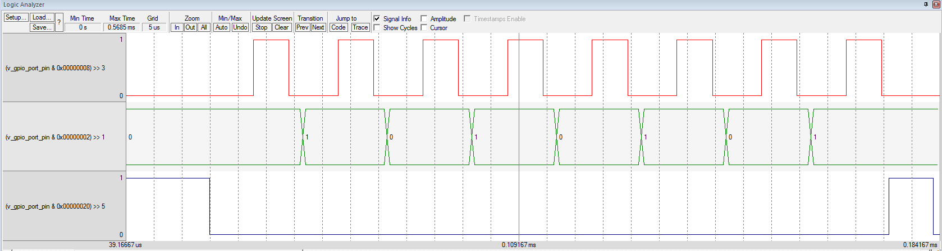
Serial Interfaces
Bit-Banging
In computer engineering and electrical engineering, bit banging is slang for any method of data transmission which employs software as a substitute for dedicated hardware to generate transmitted signals or process received signals. Software directly sets and samples the states of GPIOs (e.g., pins on a microcontroller), and is responsible for meeting all timing requirements and protocol sequencing of the signals.
Memory-mapped I/O
Memory-mapped I/O uses the same address space to address both memory and I/O devices. The memory and registers of the I/O devices are mapped to (associated with) address values. The CPU instructions used to access the memory can also be used for accessing devices. Each I/O device monitors the CPU's address bus and responds to any CPU access of an address assigned to that device, connecting the data bus to the desired device's hardware register. To accommodate the I/O devices, areas of the addresses used by the CPU must be reserved for I/O and must not be available for normal physical memory.
AREA myData, DATA
virtual_gpio_pin_register
SPACE 4
CLK
MOSI
Bit 7 Bit 6 Bit 5 Bit 4 Bit 3 Bit 2 Bit 1 Bit 0
SS

Slide 26
Serial Interfaces
Bit-Banging
In computer engineering and electrical engineering, bit banging is slang for any method of data transmission which employs software as a substitute for dedicated hardware to generate transmitted signals or process received signals. Software directly sets and samples the states of GPIOs (e.g., pins on a microcontroller), and is responsible for meeting all timing requirements and protocol sequencing of the signals.
Memory-mapped I/O
Memory-mapped I/O uses the same address space to address both memory and I/O devices. The memory and registers of the I/O devices are mapped to (associated with) address values. The CPU instructions used to access the memory can also be used for accessing devices. Each I/O device monitors the CPU's address bus and responds to any CPU access of an address assigned to that device, connecting the data bus to the desired device's hardware register. To accommodate the I/O devices, areas of the addresses used by the CPU must be reserved for I/O and must not be available for normal physical memory.
AREA myData, DATA
virtual_gpio_pin_register
SPACE 4
Bit Slot
CLK
MOSI
Bit 7 Bit 6 Bit 5 Bit 4 Bit 3 Bit 2 Bit 1 Bit 0
SS

Slide 27
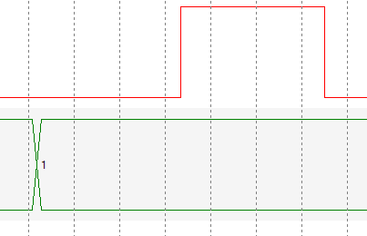
Serial Interfaces
SS EQU BIT5
CLK EQU BIT3
MOSI EQU BIT1
spi_delay EQU 10
bit_slot
;
; R2 (bit7) – bit to send
; R0 – address of virtual GPIO
; R3 – delay
; R1 – working register
PUSH {..., LR}
LDR R0, =virtual_gpio_pin_register
LDR R3, =spi_delay
LDR R1, [R0] ; Read virtual pins
; Read-Modify-Write method!
TST R2, #BIT7 ; 1. Check Bit 7
BICEQ R1, #MOSI ; Set MOSI Low
ORRNE R1, #MOSI ; or High
STR R1, [R0] ; Write pins!
BL delay ; 2. Delay
ORR R1, #CLK ; 3. Set CLK High
STR R1, [R0] ; Write pins!
BL delay ; 4. Delay
BIC R1, #CLK ; 5. Set CLK Low
STR R1, [R0] ; Write pins!
POP {..., PC}
Bit Slot: Send Bit 7 of Register R… (R2 for example) to SPI
2. Wait some time…
3. Set CLK High
4. Wait again
5. Set CLK Low
1. Set MOSI to 1 or 0 depend on Bit 7 or register

Slide 28
Serial Interfaces
N = 8
Send Byte: Send Register R… (R2 for example) over SPI
Send Bit 7
???
N = N - 1
N = 0?
2. Send 8 bits (bit 7 first, bit 0 last)
3. Set SS High
1. Set SS Low
4. Wait
CLK
MOSI
Bit 7 Bit 6 Bit 5 Bit 4 Bit 3 Bit 2 Bit 1 Bit 0
SS

Slide 29
Serial Interfaces
N = 8
Send Byte: Send Register R… (R2 for example) over SPI
Send Bit 7
LSL R2, #1
Set SS Low and High:
Read-Modify-Write
N = N - 1
N = 0?
2. Send 8 bits (bit 7 first, bit 0 last)
3. Set SS High
1. Set SS Low
4. Wait
CLK
MOSI
Bit 7 Bit 6 Bit 5 Bit 4 Bit 3 Bit 2 Bit 1 Bit 0
SS

Slide 30
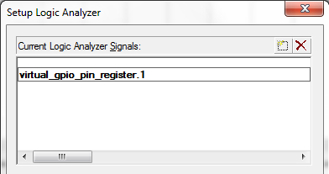

Serial Interfaces
SysInit:
Set CLK and MOSI to 0
Set SS to 1
Set Analyzer for bits
CLK
MOSI
Bit 7 Bit 6 Bit 5 Bit 4 Bit 3 Bit 2 Bit 1 Bit 0
SS

Slide 31
Serial Interfaces
LAB 9
Serial Interface
(Bit-Banging)

Slide 32
Serial Interfaces
SCK
Chapter 21 of UM10562.pdf
- LPC408x/407x User manual.
SSEL (SS)
RX Shift Reg.
MISO
SR
RX FIFO
CR1
Control Logic
DR
TX FIFO
CR0
CPSR
SCR[15:8]
Clock Generator
TX Shift Reg.
MOSI
Prescale
pclk

Slide 33
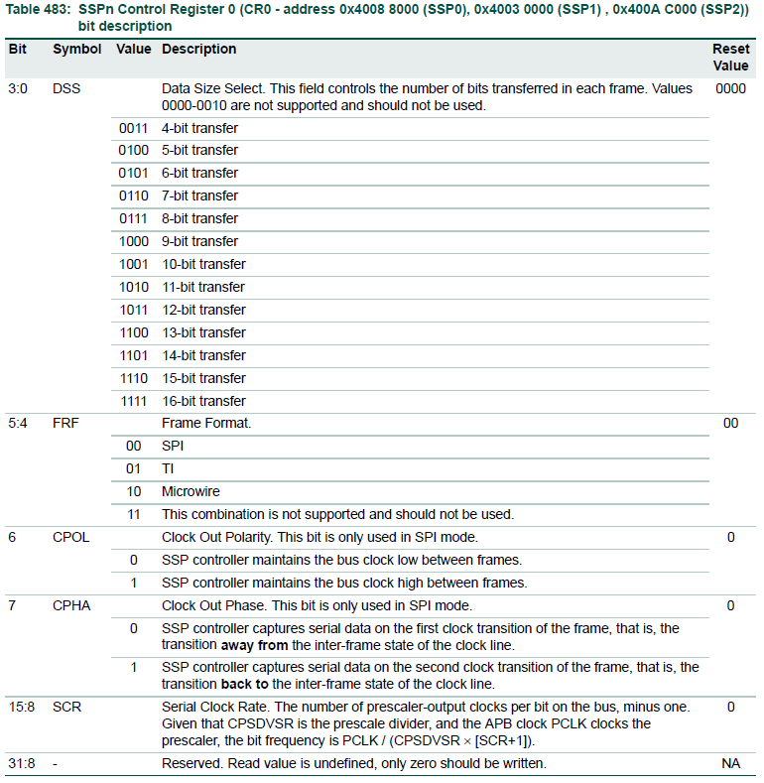
Serial Interfaces

Slide 34
Serial Interfaces
You have to set Data Size!

Slide 35
Serial Interfaces
Ok

Slide 36
Serial Interfaces
You need to set!

Slide 37
Serial Interfaces
Ok

Slide 38
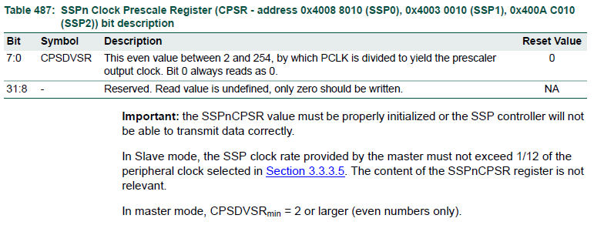
Serial Interfaces

Slide 39
Serial Interfaces
You have to set Correct number!

Slide 40
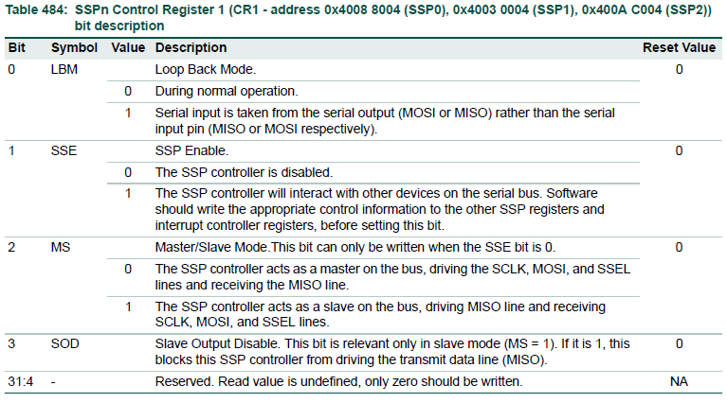
Serial Interfaces
Set all other registers first!

Slide 41
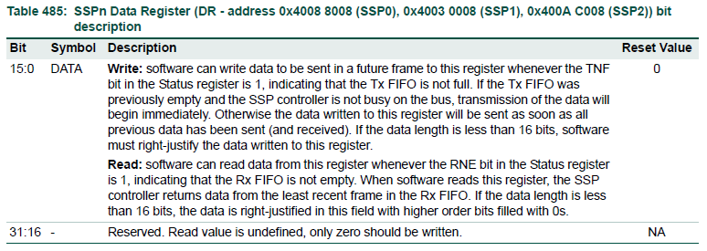
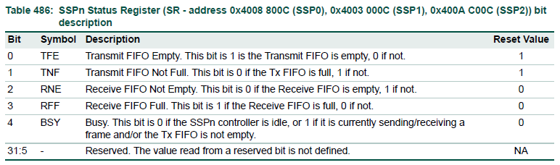
Serial Interfaces
Wait until ‘0’ in BSY bit!

Slide 42
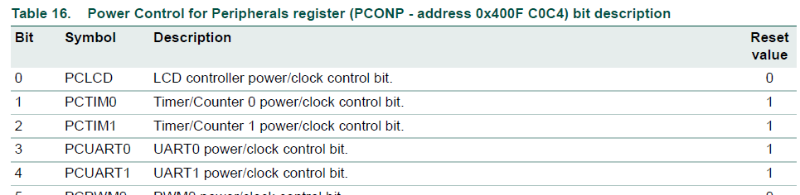
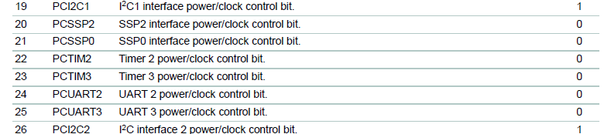
System and clock control
Power Control
ADC
3.3.2.2 Power Control for Peripherals register.
UM10562.pdf - LPC408x/407x User manual. Page 29
PCONP – address 0x400FC0C4
CPU
SSP0
Ethernet
+
CMP
-

Slide 43
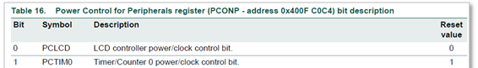
System and clock control
Power Control
Using GET BOARD.S
SYSCTLDEF.S
; ---------- Absolute addresses ------------
...
SYSR_PCONP EQU 0x400FC0C4
...
; ---------- Base/Offset addresses ---------
SYSTEM_CTRL_BASE EQU 0x400FC000
...
PCONP EQU 0x0C4
...
PCONP_PCLCD EQU 0x00000001
PCONP_PCTIM0 EQU 0x00000002
...
PCONP_PCSSP2 EQU 0x00100000
PCONP_PCSSP0 EQU 0x00200000
PCONP_PCTIM2 EQU 0x00400000
...
;
; Turn SSP0 On
; ‘Absolute address’ and
; ‘Read-Modify-Write’ methods
;
GET BOARD.S
. . .
LDR R1, =SYSR_PCONP
LDR R2, [R1] ; R2 = PCONP –- Read!
ORR R2, #PCONP_PCSSP0 ; Modify! Turn On...
STR R2, [R1] ; PCONP = R2 –- Write!
. . .

Slide 44

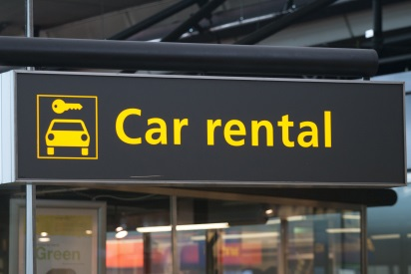
LPC4088 Peripherals
P1.24
208 Pins.
165 Input-Output pins.
6 Ports.
Ports P0 to P4 – 32 pins each.
Port P5 – 5 pins.
P1.24 – Pin 24 of Port 1.
P1[24] – Pin 24 of Port 1.
IOCON_P1_24
GPIO
GPIO P1[24]
USB_RX_DM1
USB
PWM1
PWM1[5]
Shared Input/Output Pins
QEI_IDX
QEI
T9
MC
MC_FB2
SSP0
SSP0_MOSI
LCD
LCD_VD[10]
LCD_VD[14]

Slide 45
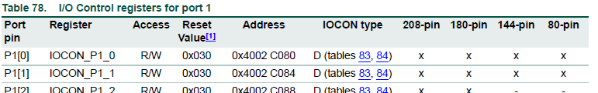
IOCON
IOCON_P1_24

Slide 46
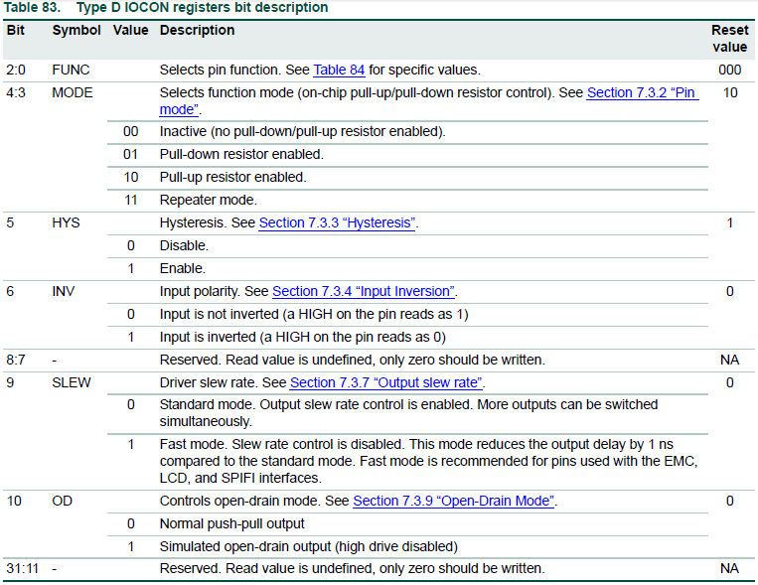
IOCON
IOCON_P1_24
All 0’s

Slide 47
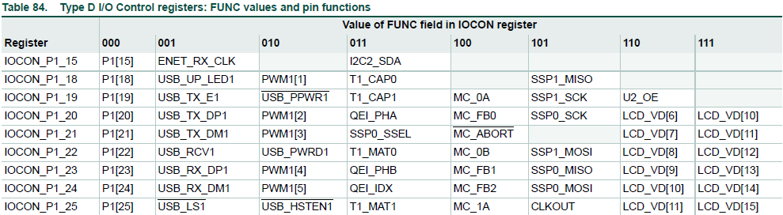
IOCON
IOCON_P1_24

Slide 48
IOCON
Using GET BOARD.S
IOCONFDEF.S
; ---------- Absolute addresses ---------------
IOCON_P0_0 EQU 0x4002C000
. . .
IOCON_P1_23 EQU 0x4002C0DC
IOCON_P1_24 EQU 0x4002C0E0
IOCON_P1_25 EQU 0x4002C0E4
. . .
; ---------- Base/Offset addresses ------------
IOCON_P0_BASE EQU 0x4002C000
IOCON_P1_BASE EQU 0x4002C080
IOCON_P2_BASE EQU 0x4002C100
; Pins definitions
. . .
PIN23 EQU (23<<2)
PIN24 EQU (24<<2)
PIN25 EQU (25<<2)
;
; Type D IOCON registers bit description
;
D_FUNC_0 EQU 0x00000000
. . .
D_FUNC_4 EQU 0x00000004
D_FUNC_5 EQU 0x00000005
. . .
D_MODE_INACTIVE EQU 0x00000000
D_MODE_PULL_DWN EQU 0x00000008
D_MODE_PULL_UP EQU 0x00000010
D_MODE_REPEATER EQU 0x00000018
D_HYST_DIS EQU 0x00000000
D_HYST_EN EQU 0x00000020
D_INV_OFF EQU 0x00000000
D_INV EQU 0x00000040
D_SLEW_STD EQU 0x00000000
D_SLEW_FAST EQU 0x00000200
D_OD EQU 0x00000400
; Set P1.24 as SSP0.MOSI Pin
; Absolute address
;
LDR R0, =IOCON_P1_24 ; Addr. Of IOCON_P1_24
MOV R1, #(D_FUNC_5) ; Conf. bits
STR R1, [R0] ; Write conf. to IOCON_P1_24
; P1.24 as SSP0.MOSI Pin
; Base-offset addressing
;
LDR R0, =IOCON_P1_BASE ; Base Addr. Of IOCON_P1
MOV R1, #(D_FUNC_5) ; Conf. bits
STR R1, [R0, #PIN24] ; Write conf. to IOCON_P1_24

Slide 49
Serial Interfaces
Using GET BOARD.S
SSPDEF.S
; ---------- Absolute addresses ---------------
SSP0_CR0 EQU 0x40088000
SSP0_CR1 EQU 0x40088004
. . .
; ---------- Base/Offset addresses ------------
SSP0_BASE EQU 0x40088000
. . .
CR0 EQU 0x000
CR1 EQU 0x004
DR EQU 0x008
SR EQU 0x00C
CPSR EQU 0x010
. . .
CR0_DSS_4 EQU 3
. . .
CR0_DSS_8 EQU 7
. . .
CR0_FRF_SPI EQU 0x00
CR0_FRF_TI EQU 0x10
CR0_FRF_MICRO EQU 0x20
CR0_CPOL_LOW EQU 0x00
CR0_CPOL_HI EQU 0x40
CR0_CPHA_FRST EQU 0x00
CR0_CPHA_SCND EQU 0x80
CR0_SCR_OFFSET EQU 8
CR1_LBM EQU 0x01
CR1_SSE EQU 0x02
CR1_MS_SLAVE EQU 0x04
CR1_SOD EQU 0x08
SR_TFE EQU 0x01
SR_TNF EQU 0x02
SR_RNE EQU 0x04
SR_RFF EQU 0x08
SR_BSY EQU 0x10
; Program SSP0 Master, 8-bit, CPOL=0, CPHA=0, Preacale = 2
; Base-offset addressing
;
LDR R0, =SSP0_BASE ; Base address of SSP0
; CR0 – Set data size and CLK polarity and phase:
LDR R1, =(CR0_DSS_8:OR:CR0_CPOL_LOW:OR:CR0_CPHA_FRST)
STR R1, [R0, #CR0] ; Write conf. bits to CR0
; Prescale
MOV R1, #2
STR R1, [R0, #CPSR] ; Write 2 to CPSR
; CR1 – Enable maser mode.
MOV R1, #CR1_SSE
STR R1, [R0, #CR1] ; Write SSP Enable to CR1
; SSP0 is ready to go!
;
...
; Send the byte 0x5A into SSP0 and wait until the byte
; is transmitted (R0 is ‘base address’)
;
MOV R1, #0x5a ; Byte to send
STR R1, [R0, #DR] ; Write to DR (send!)
wait_for_ssp
LDR R1, [R0, #SR] ; Read Status Register (SR) to R1
TST R1, #SR_BSY ; Check ‘BUSY’ bit
BNE wait_for_ssp ; If BUSY still =1, repeat
...

